Slide 1

The ABC of Iodine
A discovery guide for students and teachers

Slide 2
Iodine feedback tool
Take 5 minutes to fill out the Iodine feedback tool individually
Notes:
If the students have computers and internet available, please use the online version on the website.

Slide 3
Why is iodine important?
Iodine is an essential mineral that plays a key role in the body for a healthy life. You only need it in tiny amounts every day. It helps your thyroid gland, which controls how fast your body uses energy. It's crucial for growth and staying energised. Without enough iodine, your body might not work as it should, so it's important to make sure you get enough. The intake of iodine is important at all stages of life, but especially for children and women who plan to have a child.
You need iodine before you are born and very early in life to ensure you can grow and learn well. In the months after birth, your mother’s breast milk or formula can provide the iodine you need. After that, you need to find it in your diet from different iodine-rich foods.
An essential mineral is when a mineral is needed but your body cannot produce it, you have to get it from your diet
Notes:
Glossary: An essential mineral is when a mineral is needed but your body cannot produce it, you have to get it from your diet.
Ask students if they know what the word ‘essential mineral’ means?
Perhaps ask students if they know other essential minerals [iron, selenium, cobber, magnesium, zinc, calcium, phosphorus, potassium, sodium, chromium, chloride, fluoride – and of course iodine].

Slide 4
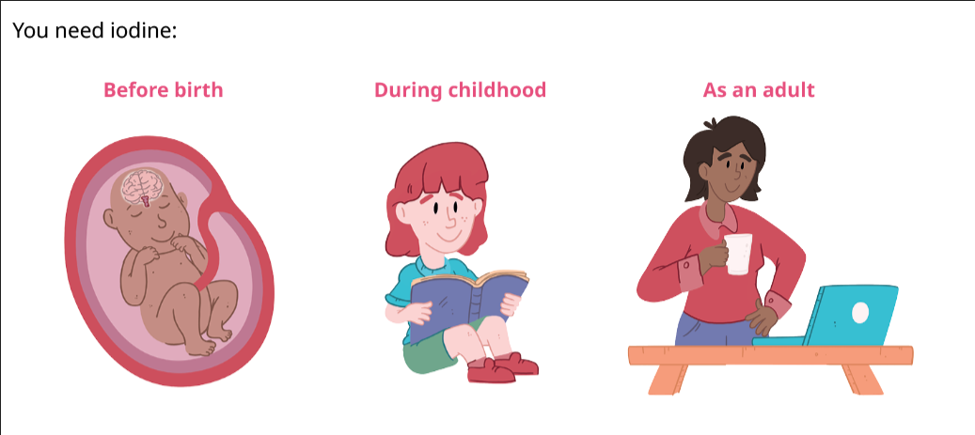
Why is iodine important?
Iodine is needed before you are born, very early in life, throughout your childhood, and when you are planning to have a baby.

Slide 5
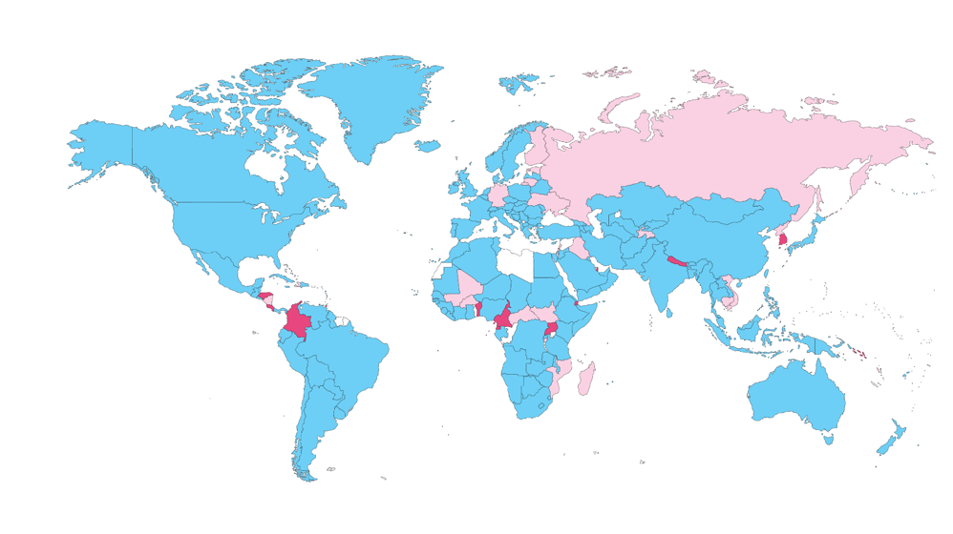
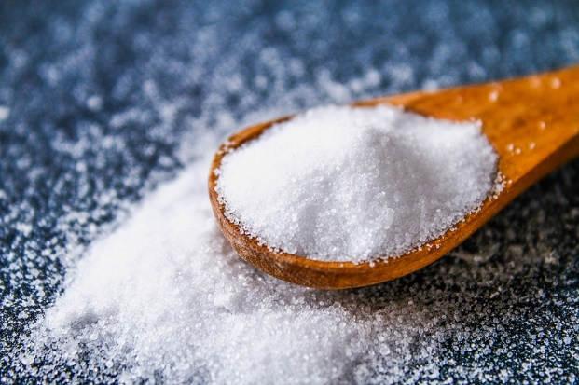
Does everyone in the world have access to iodine in their diet?
Most normal diets in many countries lack sufficient iodine.
Iodine status is monitored by governments by checking iodine content in urine during national or regional surveys.
Because of a global campaign to add iodine to household salt, much of the world’s population has access to the tiny amounts of iodine they need. However, in some countries, including the United Kingdom and the Republic of Cyprus, people do not have access to iodised salt.
Notes:
See next slide for a bigger map.

Slide 6
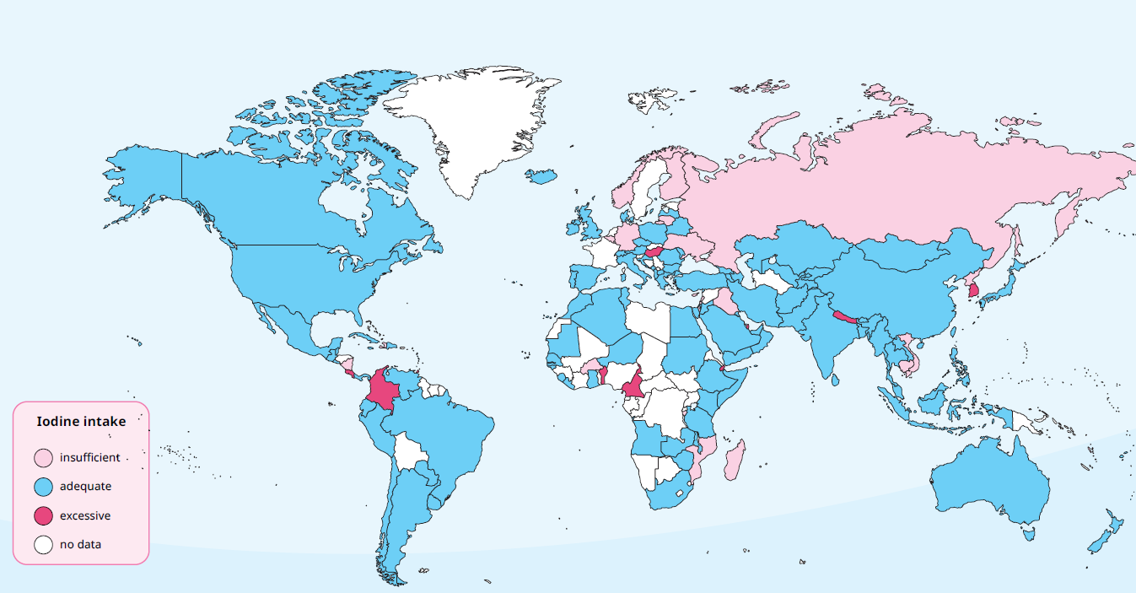
Find your country to see iodine status
Notes:
Use the zoom effect in presentation mode to highlight your country.
Perhaps ask students about countries where the population gets enough iodine, not enough – or too much.
Underline that while the intake of iodine is adequate in the general population, subgroups might have an insufficient iodine intake.

Slide 7
What is the history of iodine deficiency?
Mental impairment involves difficulties in cognitive functions such as learning, understanding, remembering, or problem-solving, which might affect an individual's ability to grasp information or interact with the world in typical ways.
Iodine deficiency has a long history. In 326 BCE, Alexander the Great saw swollen necks in residents of the northern area of present-day Pakistan. This was goitre, a swelling of the thyroid gland in the neck due to iodine deficiency.
Switzerland was the first country in the world to iodise salt (add iodine to salt) as a way of tackling the problem of iodine deficiency, and has been doing so for more than a hundred years. Before that, there were high rates of severe and permanent mental impairment, especially in regions with low iodine levels in soil and plants.
Iodine deficiency or micronutrient deficiency is when your body doesn’t get enough of something it needs, such as important vitamins and minerals, like iodine.
Notes:
Glossary: Mental impairment involves difficulties in cognitive functions such as learning, understanding, remembering, or problem-solving, which might affect an individual's ability to grasp information or interact with the world in typical ways.
Glossary: Iodine deficiency or micronutrient deficiency is when your body doesn’t get enough of something it needs, such as important vitamins and minerals, like iodine.

Slide 8
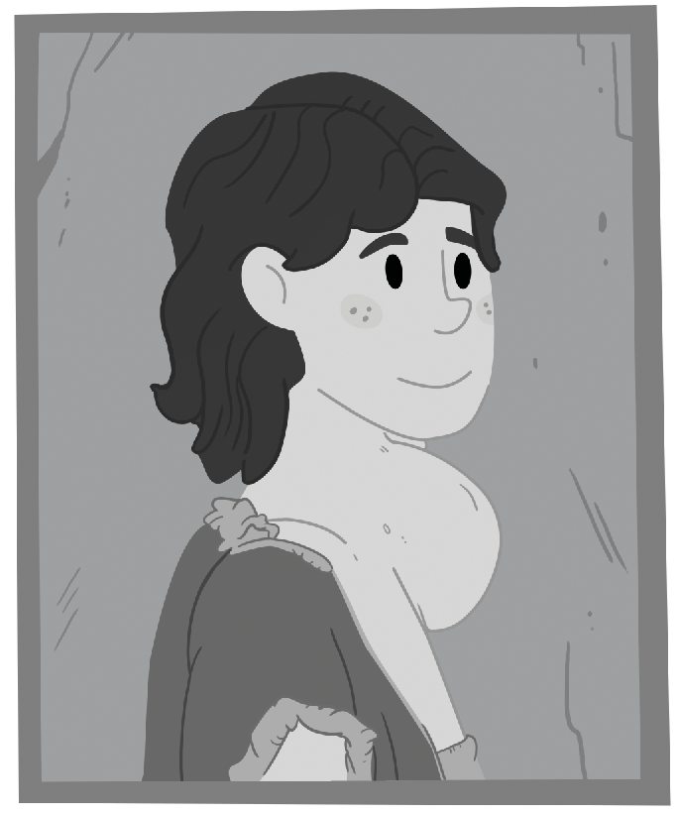
What is the history of iodine deficiency?
About 30 years ago, international leaders, the salt industry and people all over the world came together in a campaign to iodise salt, called Universal Salt Iodisation. Thanks to this campaign, we no longer see the signs of severe iodine deficiency in most parts of the world.
However, we still see moderate and mild deficiencies, mostly due to lack of attention to use of iodised salt and eating iodine-rich foods.

Slide 9

Iodine: Fueling growth and energy
You need iodine to produce thyroid hormones, which are necessary for growth and metabolism. The thyroid gland is in front of your neck, below the Adam’s apple. If it cannot produce the right amount of thyroid hormones, this may lead to negative health effects. Also, if the thyroid gland does not get enough iodine, it may lead to thyroid diseases (too little or too much of the thyroid hormone is produced). Since the thyroid hormones are important for metabolism, iodine deficiency may lead to problems regulating body temperature, fatigue, tiredness, and weight changes.
Fact
The thyroid gland is a small butterfly-shaped gland in the front of your neck, below the Adam’s apple.
Notes:
There is an extension task to this page/slide.

Slide 10
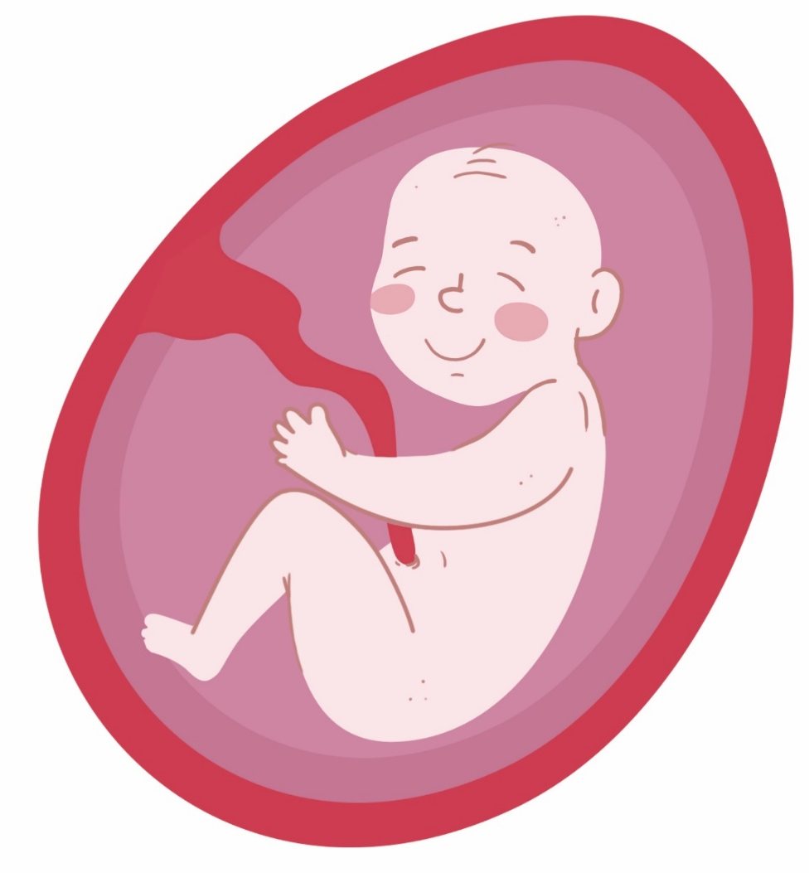
Iodine in pregnancy: growth and brain development of the baby
It’s important to have good iodine nutrition before becoming pregnant.
Iodine is crucial during pregnancy because it supports the production of thyroid hormones. These hormones are essential for the healthy development of the baby's brain and nervous system.
Thus, iodine is important for the development of cognitive abilities, learning, and overall health as the baby grows.
Notes:
There are extension tasks to this page/slide.

Slide 11
Why should we care about iodine deficiency today?
While the signs of severe iodine deficiency are fading, moderate and mild iodine deficiency still exist. As it is no longer an obvious, visible issue, many people do not know about the importance of having enough iodine in their diets.
Iodine deficiency can impact the health of all population groups, and it is the largest preventable cause of mental impairment.

Slide 12
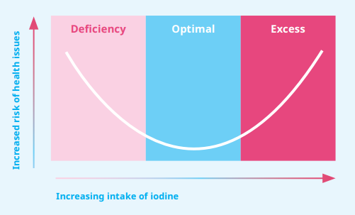
Getting the proper amount of iodine is important for good health
One might think that if a little iodine is good for human health, then consuming more iodine is even better. But like many nutrients, you can have too much of it. Ensuring an adequate but not excessive iodine intake is essential for health.

Slide 13
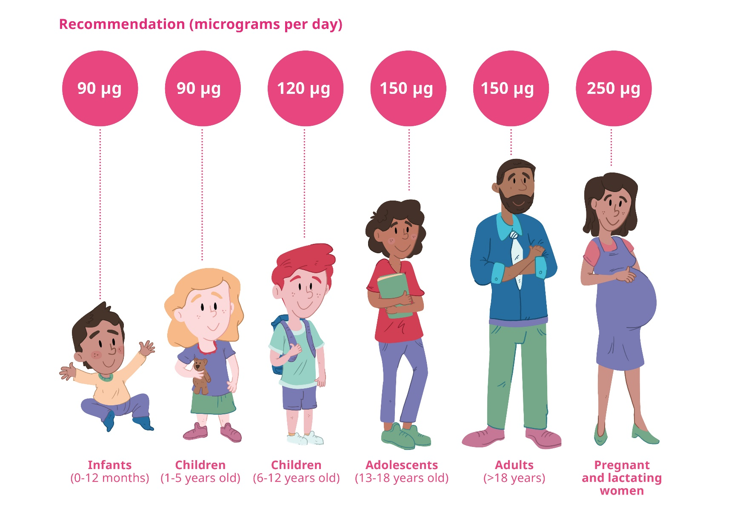
Recommended intake
– also for pregnancy and breastfeeding
The World Health Organisation (WHO) recommends the following iodine intake per day (2007). These recommendations are based on the average daily intake of iodine necessary to maintain thyroid hormones and overall well-being for different age groups and life stages.

Slide 14
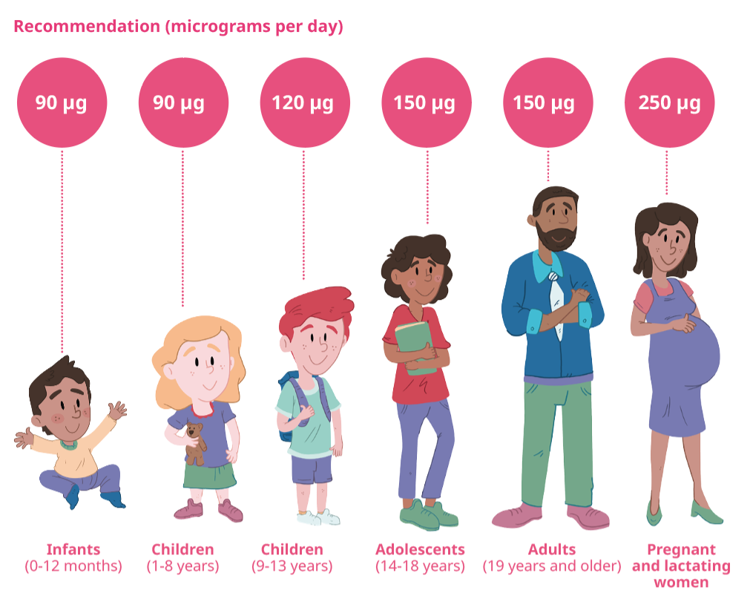
Recommended intake
Fact
A µg (microgram) is such a small amount that it’s hard to illustrate. The amount of iodine you need a day is so small that you will need less than a teaspoon of iodine your entire lifetime.

Slide 15
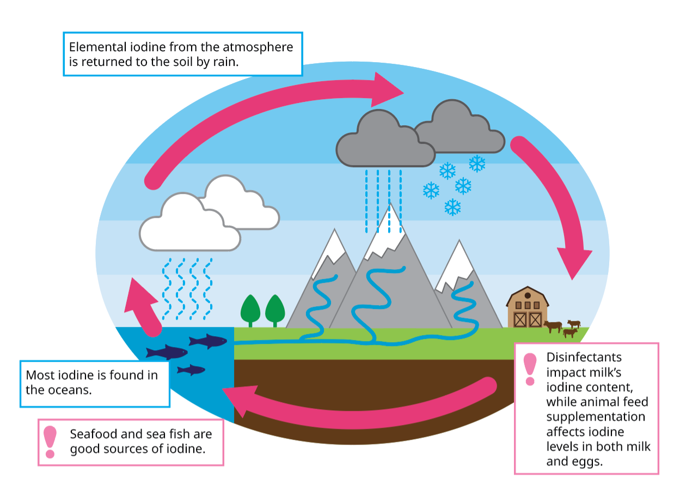
The iodine cycle
Iodine's journey starts in the ocean, where fish, shellfish and seaweed absorb it from sea water. From the ocean, iodine evaporates into the air in tiny droplets. These droplets fall on land when it rains, and the soil absorbs the iodine.

Slide 16
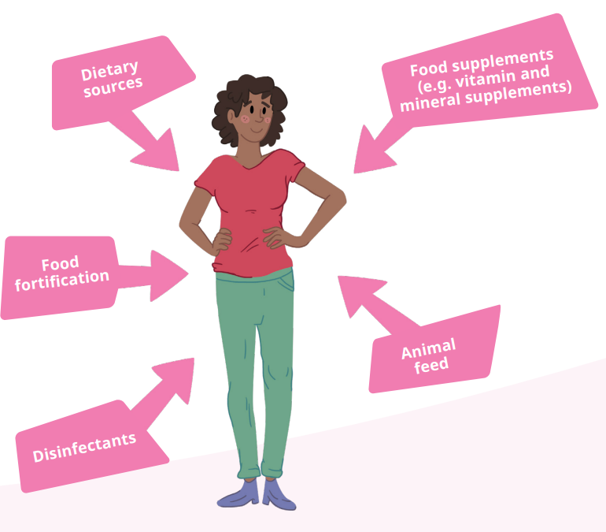
The iodine cycle
Furthermore, national regulations on iodine content in animal feed, food fortification, and salt iodisation programmes influence the level of iodine in foods. In some countries, iodine is also used as a disinfectant during milking and so milk and dairy products are also a good source of iodine in your diet. Hence, iodine enters the food chain in various ways.
Fortification is when essential vitamins or minerals, like iodine, are added to certain foods such as salt, bread, cereals, or milk. The aim is to increase the amount of certain nutrients in particular foods and make sure that people get enough of the important vitamins and minerals.
Notes:
Glossary: Fortification is when essential vitamins or minerals, like iodine, are added to certain foods such as salt, bread, cereals, or milk. The aim is to increase the amount of certain nutrients in particular foods and make sure that people get enough of the important vitamins and minerals.

Slide 17
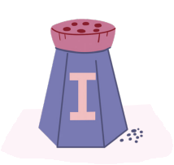
How can countries ensure that people are getting enough iodine in their diets?
Countries may have different ways of ensuring that their population consumes enough iodine. Many countries have salt iodisation programmes, but they may differ in terms of how much iodine is added to salt (this depends on how much iodine people in a particular country need). In some countries, it is mandatory to use iodised salt (salt with added iodine) to produce bread and ready-made foods, whereas in others, it is voluntary.

Slide 18

How can countries ensure that people are getting enough iodine in their diets?
There are also other ways iodine is introduced into the food chain, including fortification of animal feed and the use of biocides in food production. These affect how much iodine ends up in foods such as milk and eggs because of what the animals eat or how the foods are produced.
Legislation regarding iodised salt, food culture and geographical conditions may create significant differences in iodine intake between countries – even those that are geographically close to each other.

Slide 19
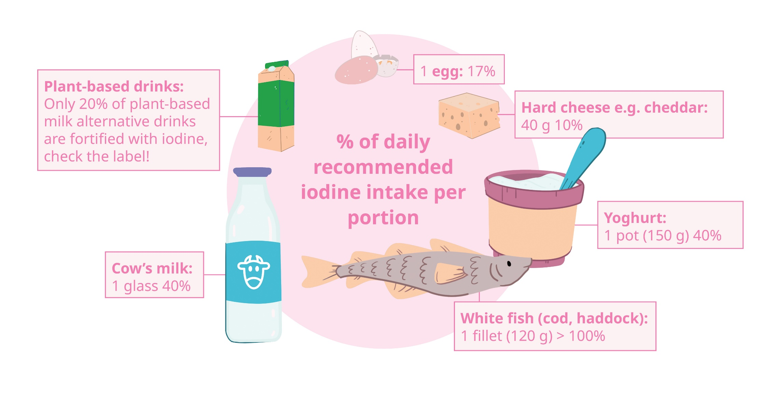
Iodine sources
Portion sizes to get the recommended amounts of iodine through diet
Notes:
NOTE! This is a country specific page – the current version is the one belonging to the UK.

Slide 20

Isn’t salt bad for us?
WHO supports salt iodisation as the best strategy to ensure that people get enough iodine. But WHO is also concerned about how much salt people eat because it can cause other health problems, such as high blood pressure, heart disease, and stroke. What people really need to do is eat less salt, but make sure it’s iodised.

Slide 21
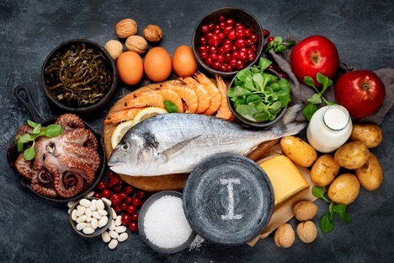
Designing iodine-rich meals: A group exercise
In a small group or two and two together, come up with a meal for lunch rich in iodine.
You can also choose to compose the three main meals for a pregnant/ non-pregnant women, a vegetarian, or a vegan, ensuring their iodine needs are met.
Present your work to the others and discuss it with your classmates.
Notes:
There is an extension task to this page/slide.
Highlight: In those cases where it is difficult to cover iodine needs through the diet, e.g. a vegetarian or a vegan woman who wants to get pregnant, supplements might be necessary.

Slide 22
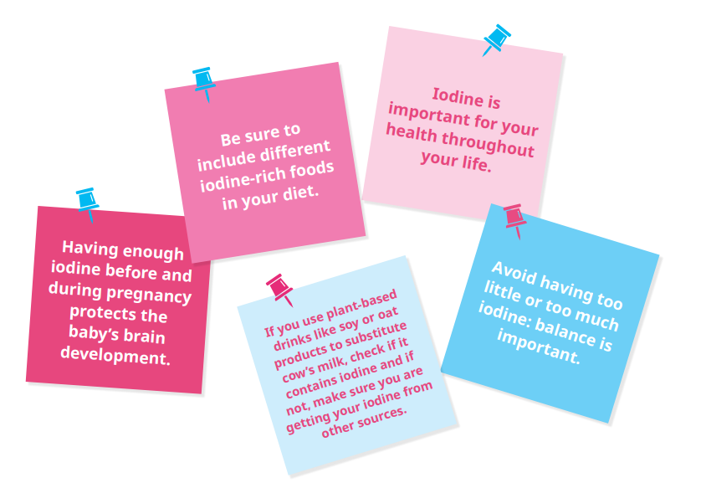
Things to remember

Slide 23

Crossword
1. Iodine is important for the development of the baby’s _____.
2. Thyroid hormones are produces in the _______ gland.
3. As an adolescent, you need 150 micrograms of iodine per _____.
4. ____ is a good marine source of iodine.
5. Women need a higher iodine intake per day during ________.
6. Iodine deficiency may lead to the enlargement of the thyroid, this is called ______.
Notes:
1. Iodine is important for the development of the baby’s _brain_.
2. Thyroid hormones are produced in the _thyroid_ gland.
3. As an adolescent, you need 150 micrograms of iodine per _day_.
4. _Fish_ is a good marine source of iodine.
5. Women need a higher iodine intake per day during _pregnancy_.
6. Iodine deficiency may lead to the enlargement of the thyroid, this is called _goitre_.

Slide 24
Spot the errors
Adequate iodine intake is essential to prevent iron deficiency.
Having enough iodine in the diet is especially important during old age.
A global campaign 100 years ago to iodise salt helped reduce the incidence of deafness.
Apart from iodised salt, other important sources of iodine are chocolate and rice.
Notes:
Right answers:
Adequate iodine intake is essential to prevent iodine deficiency.
Having enough iodine in the diet is especially important during pregnancy.
A global campaign 30 years ago to iodise salt helped reduce the incidence of goitre.
Apart from iodised salt, other important sources of iodine are seafood and dairy products.

Slide 25
Module A exercises - answers
A1: Which functions do iodine influence and regulate in your body? (You can mark multiple choices.)
Blood circulation
Metabolism
Brain development, especially during pregnancy and early childhood
Reproductive functions and fertility
Respiratory function
Growth and development, particularly during childhood and adolescence
Notes:
Right answers:
Metabolism
Brain development, especially during pregnancy and early childhood
Growth and development, particularly during childhood and adolescence

Slide 26
Module A exercises - answers
A1: Which functions do iodine influence and regulate in your body? (You can mark multiple choices.)
Blood circulation
Metabolism
Brain development, especially during pregnancy and early childhood
Reproductive functions and fertility
Respiratory function
Growth and development, particularly during childhood and adolescence
Notes:
Right answers:
Metabolism
Brain development, especially during pregnancy and early childhood
Growth and development, particularly during childhood and adolescence

Slide 27
Module A exercises - answers
A2: Fill in the blanks
Insufficient iodine in the diet might lead to a condition known as ___________, characterised by an enlarged ___________.
The u-shaped curve illustrates that you can get both too _______ and too _______ iodine.
When there is too little iodine, it may result in ___________ and impaired ___________ development.
Notes:
Right answers:
Insufficient iodine in the diet might lead to a condition known as ___goitre___, characterised by an enlarged _thyroid gland_.
The u-shaped curve illustrates that you can get both too __much_ and too _little_ iodine.
When there is too little iodine during pregnancy, it may result in _deficiency_ and impaired _brain_ development.

Slide 28
Module A exercises - answers
A3: Which foods are good iodine sources? (You can choose more than one answer)
Eggs
Bread
Cereals
Milk and dairy products
Fish and seafood
Fruits and vegetables
Potatoes
Vegetable oils
Iodised salt
Notes:
Right answers:
Eggs
Milk and dairy products
Fish and seafood
Iodised salt

Slide 29
Module A exercises - answers
A3: Which foods are good iodine sources? (You can choose more than one answer)
Eggs
Bread
Cereals
Milk and dairy products
Fish and seafood
Fruits and vegetables
Potatoes
Vegetable oils
Iodised salt
Notes:
Right answers:
Eggs
Milk and dairy products
Fish and seafood
Iodised salt

Slide 30
Module A exercises - answers
A4: How much iodine does WHO advise adolescents to consume per day?
100 µg
150 µg
200 µg
250 µg
350 µg
600 µg
1000 µg
Notes:
Right answer:
150 µg

Slide 31
Module A exercises - answers
A4: How much iodine does WHO advise adolescents to consume per day?
100 µg
150 µg
200 µg
250 µg
350 µg
600 µg
1000 µg
Notes:
Right answer:
150 µg

Slide 32
Module A exercises - answers
A5: How much iodine does WHO advise pregnant women to consume per day?
75 µg
100 µg
150 µg
175 µg
200 µg
250 µg
600 µg
1000 µg
Notes:
Right answer:
250 µg

Slide 33
Module A exercises - answers
A5: How much iodine does WHO advise pregnant women to consume per day?
75 µg
100 µg
150 µg
175 µg
200 µg
250 µg
600 µg
1000 µg
Notes:
Right answer:
250 µg

Slide 34
Module A exercises - answers
A6: Why is iodine vital during pregnancy? (You can choose more than one answer)
It is important for the development of the baby's bones and teeth
It is important for the development of the baby’s brain and nervous
system
It ensures the baby's overall growth
It is important for the development of the baby’s organs and skin
Notes:
Right answers:
It is important for the development of the baby’s brain and nervous system
It ensures the baby's overall growth

Slide 35
Module A exercises - answers
A6: Why is iodine vital during pregnancy? (You can choose more than one answer)
It is important for the development of the baby's bones and teeth
It is important for the development of the baby’s brain and nervous
system
It ensures the baby's overall growth
It is important for the development of the baby’s organs and skin
Notes:
Right answers:
It is important for the development of the baby’s brain and nervous system
It ensures the baby's overall growth

Slide 36
Module A exercises - answers
A7: How many or how much?
How many eggs should you eat a day to have enough iodine as an adolescent?
2 eggs
5 eggs
6 eggs
9 eggs
Notes:
Right answer:
For the UK: 6
Attention: Please emphasise, that this is just an exercise. It is important to include more iodine sources in your diet, and not exclusively eggs.

Slide 37
Module A exercises - answers
A7: How many or how much?
How many portions of white fish should you eat a day to have enough iodine as an adolescent?
1 portion
2 portions
3 portions
4 portions
Notes:
Right answer:
1 portion

Slide 38
Module A exercises - answers
A7: How many or how much?
How many glasses of cow’s milk should you drink a day to have enough iodine as an adolescent?
1 glass of milk
2-3 glasses of milk
5 glasses of milk
10 glasses of milk
Notes:
Right answer:
For the UK: 2-3

Slide 39
Group work in module B
Iodine awareness quest: crafting a community questionnaire
Assignment
Work with your classmates to create a questionnaire that asks family and friends or people in your community about iodine and how it affects their health.
How to make a questionnaire and how to do the study? See more on the ABC of iodine platform
Iodine investigation: exploring local food sources
Assignment
Explore local stores and markets to uncover iodine-rich foods. Collaborate with your group to select stores, examine products, and document findings. Prepare a presentation for the class. Alternatively, conduct an online search.
Find guidelines for your investigation on the ABC of iodine platform
Iodine detective: exploring family food records
Assignment
Work together with your group to create iodine food records, focusing on where they get iodine in their diets. Use the iodine feedback tool.
How to make a food record? See more on the ABC of iodine platform
Tracing iodine: mapping global fortification programmes
Assignment
You and your group will study and compare iodine fortification programmes in different countries, including your own.
Learn more on fortification programmes on the ABC of iodine platform
Notes:
The assignment ‘Tracing iodine: mapping global fortification programmes’ requires internet access for the students.
Prepare for the group work by deciding:
which of the four assignments students can choose, or make a pre-selection where you pick the assignment(s)
on group size, it will depend on the number of students and the chosen assignment
how you will divide students into groups
When introducing the group work make sure to:
provide clear instructions for the assignment, including precise guidance on what students need to do and details on the expected outcome of their group work
explain to students on which criteria their class presentations will be evaluated
For module B and C group presentations can be evaluated by the following criteria:
students' ability to formulate research questions
gather and analyse data
how effectively students have worked in the group
students’ ability to share ideas, and communicate their findings
students' originality and creativity

Slide 40
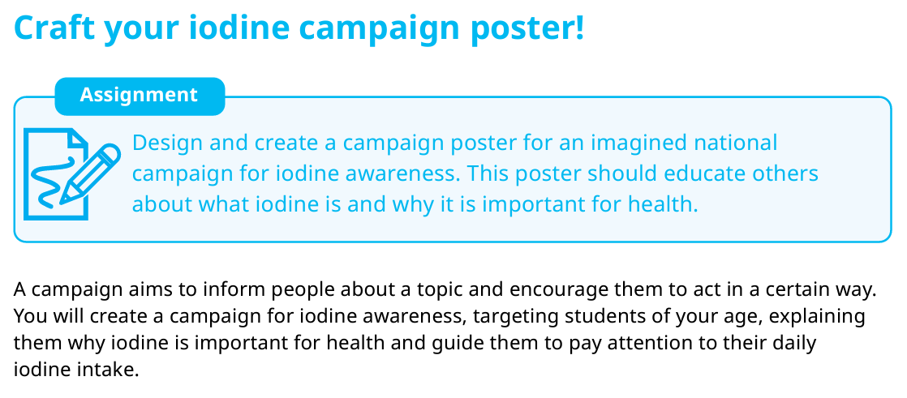
Group work in module C
Notes:
When introducing the group work make sure to:
provide clear instructions for the assignment, including precise guidance on what students need to do and details on the expected outcome of their group work
explain to students on which criteria their class presentations will be evaluated
For module B and C group presentations can be evaluated by the following criteria:
students' ability to formulate research questions
gather and analyse data
how effectively students have worked in the group
students’ ability to share ideas, and communicate their findings
students' originality and creativity

